Slide 1
Ontology support of clinical, epidemiological, and microbiome data exploration
Chris Stoeckert, Ph.D.
Research Professor of Genetics
Microbiology for the CTSA: Ontological Approaches
CTSOG 2017 Ann Arbor, MI

Slide 2
Metadata is not enough
MicrobiomeDB as a relevant example
Approach taken at EuPath to capture study and specimen details
Reification and referents
Ultimately want to use ontology expressivity; ontology is not just for tagging
Penn TURBO project as example work in progress

Slide 3
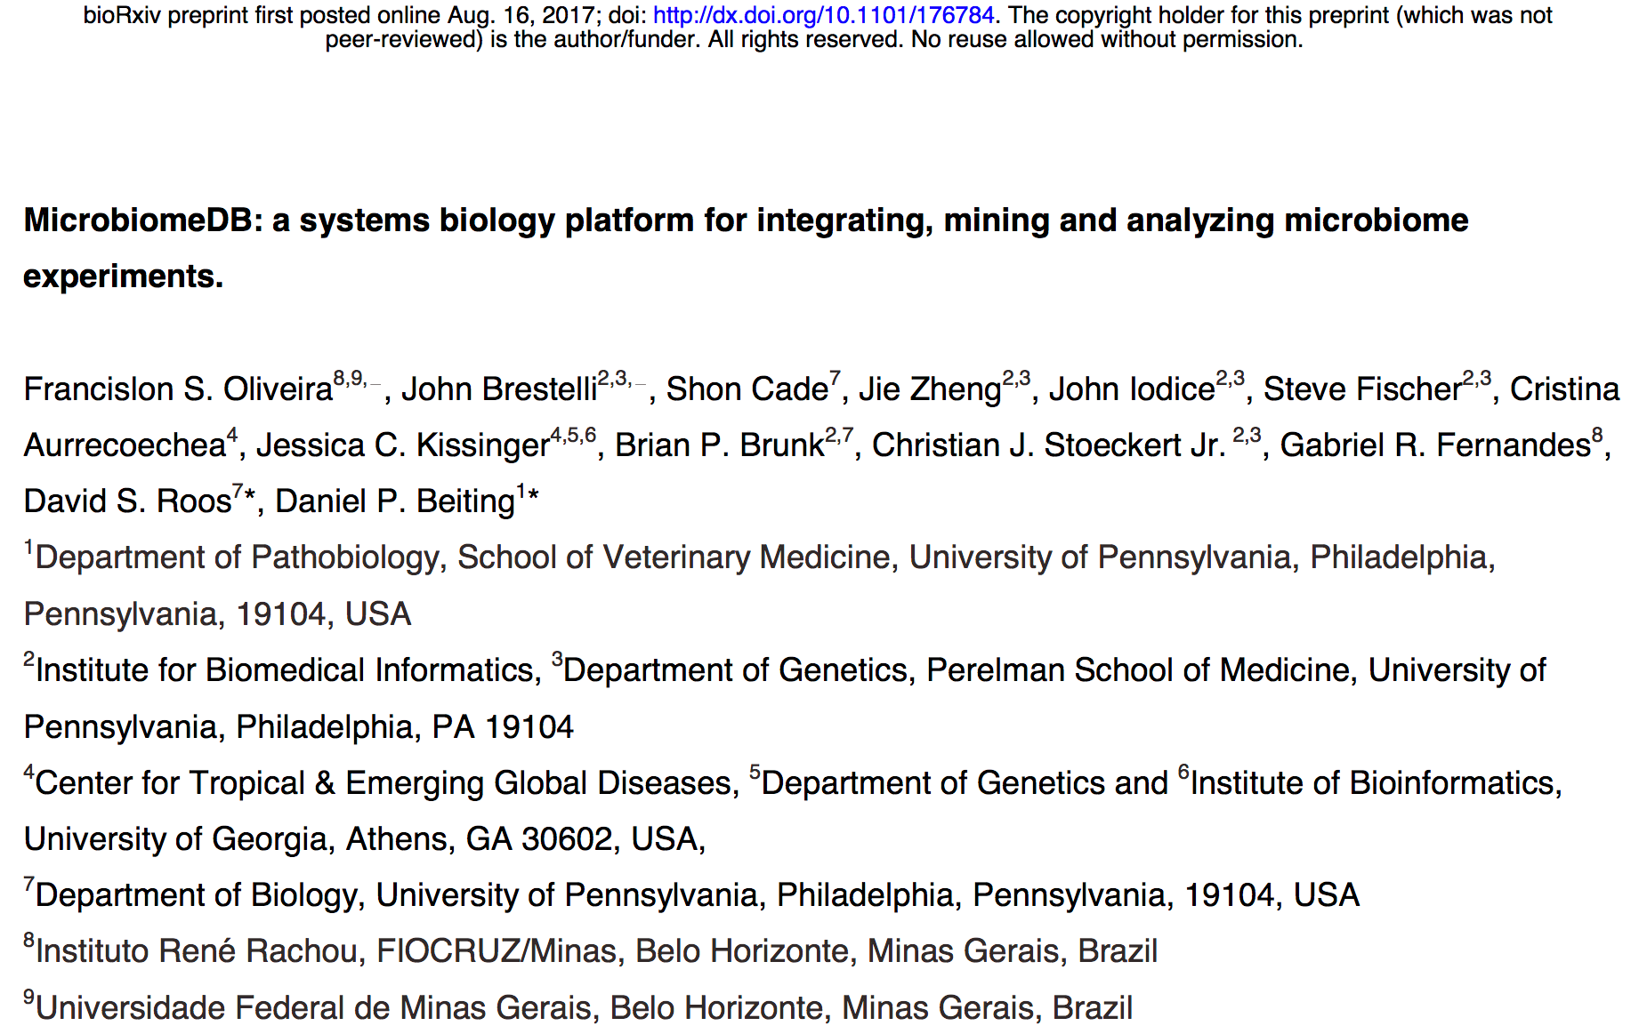
Metadata is not enough
http://microbiomedb.org/
Notes:
healthy humans, early life, families, also bees

Slide 4
Metadata is not enough
Which sites show the lowest species diversity across the human body?
How does community composition in the gut change with age?
How does the region of 16S sequenced influence composition of the skin microbiome?
How do the oral communities of dogs and humans differ?
What is the impact of delivery mode and diet on the infant gut microbiome?

Slide 5
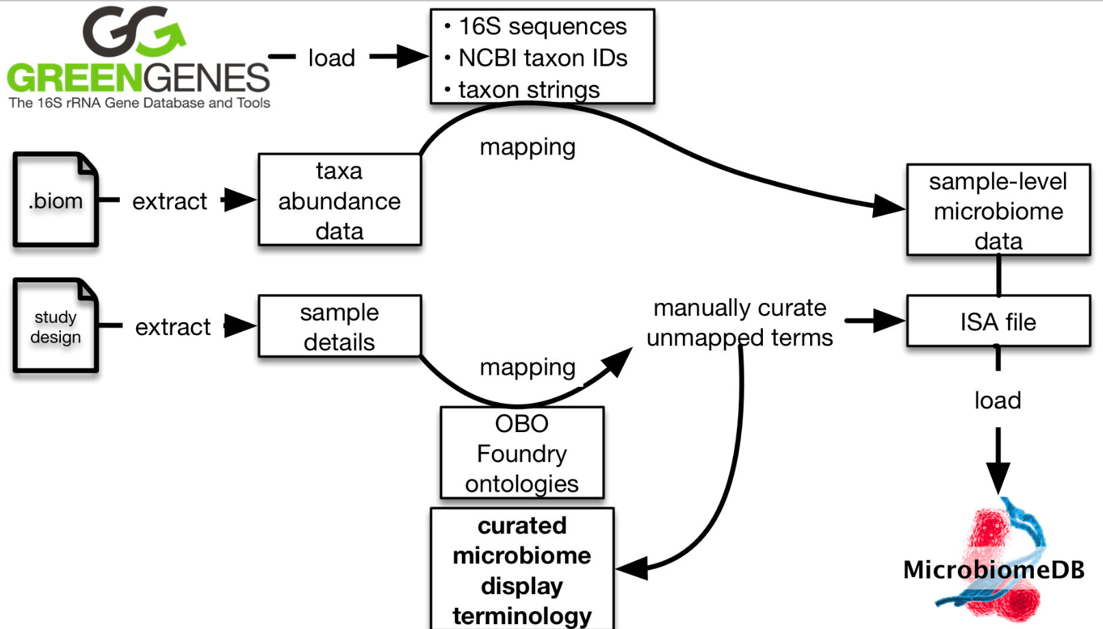
The point of MicrobiomeDB is to enable more than just looking at diversity of species but to understand the basis of that diversity
Metadata is not enough
Which sites show the lowest species diversity across the human body?
“metadata”

Slide 6
The point of MicrobiomeDB is to enable more than just looking at diversity of species but to understand the basis of that diversity
Metadata is not enough
What is the impact of delivery mode and diet on the infant gut microbiome?
“metadata”

Slide 7
The Ontological Challenge
Metadata is not enough
Microbiome data is not the problem; it can be very simple.
e.g., 16S ribosomal sequence reads as markers for bacterial species
The problem is interpreting microbiome data as that means understanding the nature of where the microbiome resided that was sampled.
Environment can be soil or fecal matter or something else
Why we care about microbiome is that they tell us about the health of what was sampled.
Composition of microbiome reflects influences and interactions
The ontological challenge is how to effectively capture data on microbiome environment, influences, and interactions in a computer processable form.
Without structure and standardization, microbiome data from different studies are not comparable.
It’s a big problem because it involves different scales and interactions across them.
Need to connect across multiple reference domains

Slide 8
The scales involved with host microbiome interactions
Metadata is not enough
https://researcher.watson.ibm.com/researcher/view_group.php?id=5372

Slide 9
Metadata is not enough
Metadata is not enough
metadata = data about data
Useful for traditional relational databases
e.g. Minimum Information about any (x) Sequence (MIxS) standard
Not enough for fully understanding what the data is about
data microbiome
X

Slide 10
Minimum Information about any (x) Sequence (MIxS)
Metadata is not enough
Part of the Environmental package
http://gensc.org/files/2015/07/MIxS_v4.xls
Package item | Definition | Requirement | Expected value | Value syntax
altitude | the altitude of the sample is the vertical distance between Earth's surface above sea level and the sampled position in the air | M | measurement value | {float} m
elevation | the elevation of the sampling site as measured by the vertical distance from mean sea level | C | measurement value | {float} {unit}
barometric pressure | force per unit area exerted against a surface by the weight of air above that surface | X | measurement value | {float} {unit}
carbon dioxide | carbon dioxide (gas) amount or concentration at the time of sampling | X | measurement value | {float} {unit}
carbon monoxide | carbon monoxide (gas) amount or concentration at the time of sampling | X | measurement value | {float} {unit}
chemical administration | list of chemical compounds administered to the host or site where sampling occurred, and when (e.g. antibiotics, N fertilizer, air filter); can include multiple compounds. For Chemical Entities of Biological Interest ontology (CHEBI) (v 111), http://purl.bioontology.org/ontology/CHEBI | X | CHEBI;timestamp | {term}; {timestamp}
How were these measured? Affects how to compare measurements from different studies.
Which compounds are antibiotics? Antimicrobial role in ChEBI.
How are these data elements related? What do they refer to in common?

Slide 11
OBO Foundry/Friendly Ontologies cover multiple scales
Metadata is not enough
Population and Community Ontology
NCBI Taxon
Uberon
Cell Ontology
Protein Ontology
Gene Ontology
ChEBI
Ontology of Host-Microbiome Interactions
OMP, MicrO
Interoperability enables bringing these together in an application ontology
(such as the EuPath Ontology)
Ideally, these ontologies enable relating data captured at different scales.

Slide 12
A common language and logic: OBO Foundry Ontologies
Metadata is not enough
OBO = Open Biological and Biomedical Ontologies
Shared design and modeling principles = Interoperable.
Orthogonal – reuse existing terms defined in OBO Foundry ontologies
Over 100 reviewed and candidate ontologies available to cover various biological and clinical domains:
Gene ontology (GO): An ontology for describing the function of genes and gene products.
Chemical Entities of Biological interest (ChEBI): A structured classification of molecular entities of biological interest focusing on 'small' chemical compounds.
Ontology for Biomedical Investigations (OBI): An integrated ontology for the description of life-science and clinical investigations.
Basic Formal Ontology (BFO): The upper level ontology upon which OBO Foundry ontologies are built.
Modeling reality
not database schemas or usage in a specific project.
For more about the OBO Foundry see: http://www.obofoundry.org

Slide 13
MicrobiomeDB workflow
Metadata is not enough

Slide 14
Web terminology versus Ontology
Metadata is not enough
Different ways to indicate the age of the individual from whom the microbiome specimen was collected.
age
age at enrollment
host age
age since birth measurement datum (http://purl.obolibrary.org/obo/OBI_0001169)

Slide 15
Web terminology versus Ontology
Metadata is not enough
Organization of information on web site is topical rather than a class hierarchy
Study summary
Sample source information
Sample information
Sample type
Experimenter notes
Sample collection
Sample collection device or method
Collection date
Sequencing assay
sequencing batch
Sequencing center
Region of 16S sequenced
Notes:
Showing MicrobiomeDB both because of relevance to the workshop topic but also to simply illustrate the points. This same approach is being used with datasets with much more complexity.

Slide 16
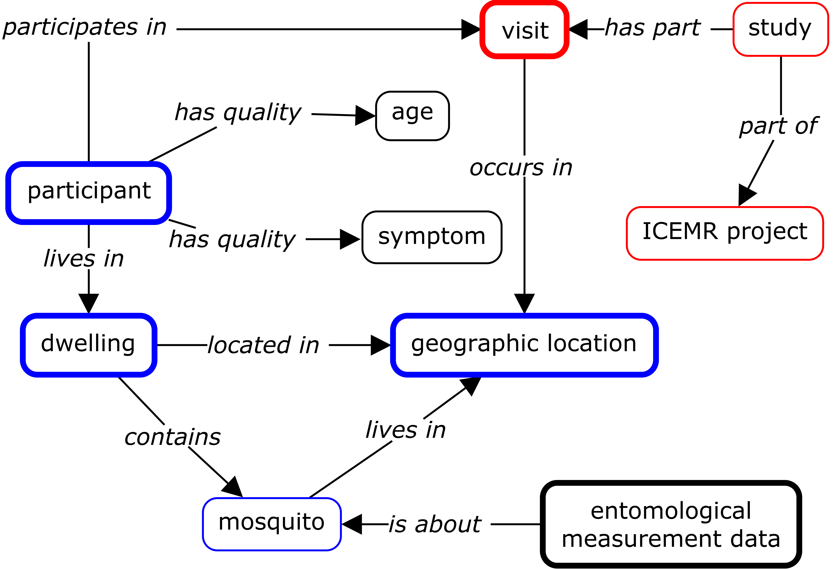
Relation of data dictionaries to ontologies and web terminologies
Metadata is not enough
Data
dictionaries
Realist Ontology
International
Centers of
Excellence for
Malaria
Research
Notes:
http://ceur-ws.org/Vol-1747/IT503_ICBO2016.pdf

Slide 17
Relation of data dictionaries to ontologies and web terminologies
Metadata is not enough
Data
dictionaries
Realist Ontology
Web site
Data dictionary | Ontology term ID | Ontology term label | ICEMR display name
abdominalpain | HP_0002027 | Abdominal pain | Abdominal pain
apainduration | EUPATH_0000154 | duration of abdominal pain | Abdominal pain duration
Anorexia | SYMP_0000523 | anorexia | Anorexia
aduration | EUPATH_0000155 | duration of anorexia | Anorexia duration
Cough | SYMP_0000614 | cough | Cough
cduration | EUPATH_0000156 | duration of cough | Cough duration
Diarrhea | DOID_13250 | diarrhea | Diarrhea
dduration | EUPATH_0000157 | duration of diarrhea | Diarrhea duration
Fatigue | SYMP_0019177 | fatigue | Fatigue
fmduration | EUPATH_0000158 | duration of fatigue | Fatigue duration
febrile | EUPATH_0000097 | febrile | Febrile
fever | EUPATH_0000100 | subjective fever | Fever (subjective)
Headache | HP_0002315 | Headache | Headache
hduration | EUPATH_0000159 | duration of headache | Headache duration
Jaundice | HP_0000952 | Jaundice | Jaundice
jduration | EUPATH_0000160 | duration of jaundice | Jaundice duration
jointpains | SYMP_0000064 | joint pain | Joint pains
djointpains | EUPATH_0000161 | duration of joint pains | Joint pains duration
muscleaches | EUPATH_0000252 | Muscle aches | Muscle aches
mduration | EUPATH_0000162 | duration of muscle aches | Muscle aches duration
rfa | OGMS_0000015 | clinical history | Other medical complaint
seizure | SYMP_0000124 | seizure | Seizures
sduration | EUPATH_0000163 | duration of seizures | Seizures duration
fduration | EUPATH_0000164 | duration of subjective fever | Subjective fever duration
Vomiting | HP_0002013 | Vomiting | Vomiting
vduration | EUPATH_0000165 | duration of vomiting | Vomiting duration
International
Centers of
Excellence for
Malaria
Research
Zheng et al. Malaria study data integration and information retrieval based on OBO Foundry ontologies.
http://ceur-ws.org/Vol-1747/IT503_ICBO2016.pdf
Notes:
http://ceur-ws.org/Vol-1747/IT503_ICBO2016.pdf

Slide 18
MicrobiomeDB workflow
Metadata is not enough
EuPath ontology

Slide 19
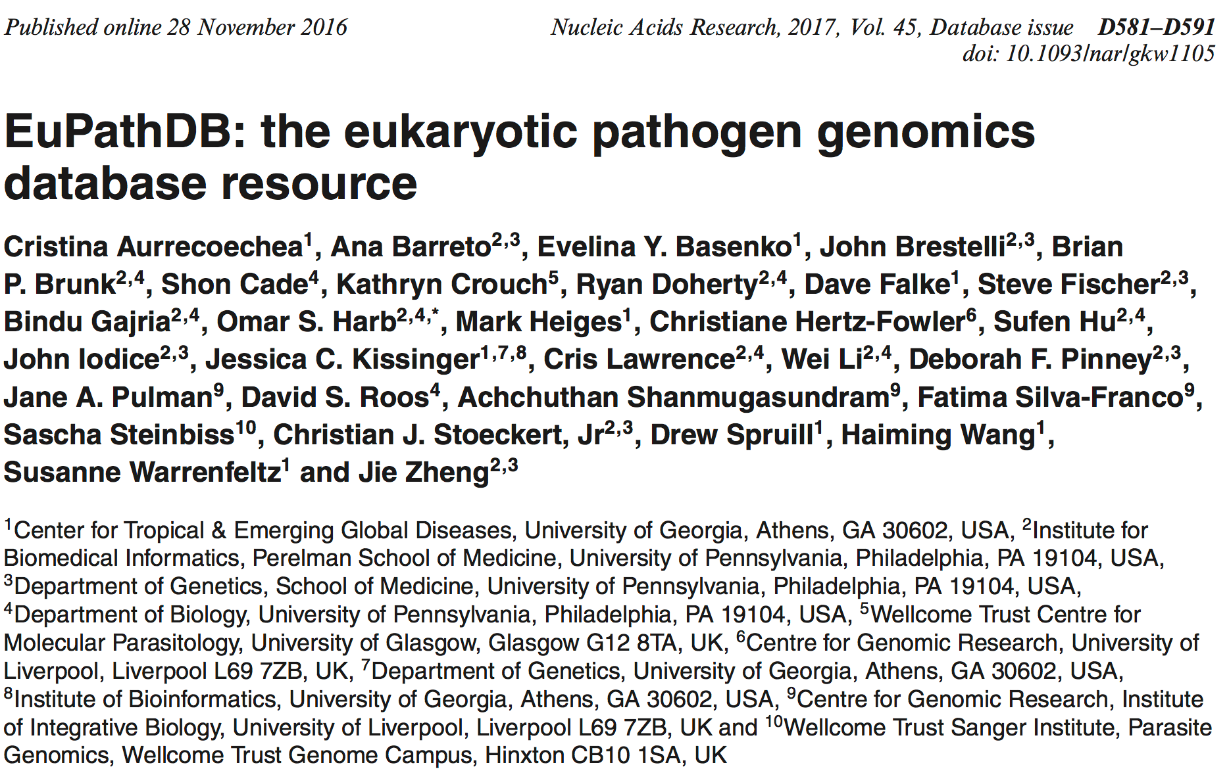
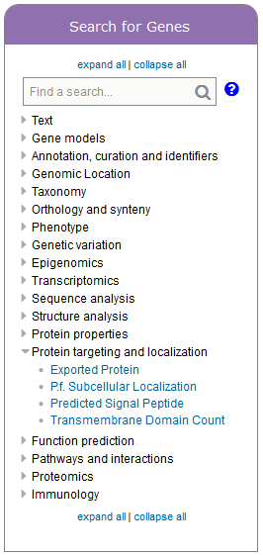
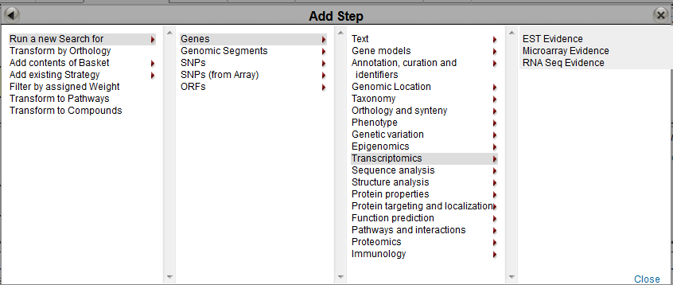
MicrobiomeDB is built using EuPathDB infrastructure
Metadata is not enough
A
B
MicrobiomeDB uses the EuPath Ontology
C
RNASeq-Polysom
1071 Genes

Slide 20
Purpose of the EuPath ontology
Metadata is not enough
The EuPath ontology is an application ontology developed to encode our understanding of what data is about in the public resources developed and maintained by the Eukaryotic Pathogen Database Bioinformatics Resource Center (EuPathDB; http://eupathdb.org).
The EuPath ontology was built based on the Ontology of Biomedical Investigations (OBI) with integration of other OBO ontologies such as PATO, OGMS, DO, etc. as needed for coverage.
Currently the EuPath ontology is primarily intended to be used for support of the EuPathDB sites. Terms with EuPath ontology IDs that are not specific to EuPathDB will be submitted to OBO Foundry ontologies for subsequent import and replacement of those terms when they are available.
https://bioportal.bioontology.org/ontologies/EUPATH

Slide 21
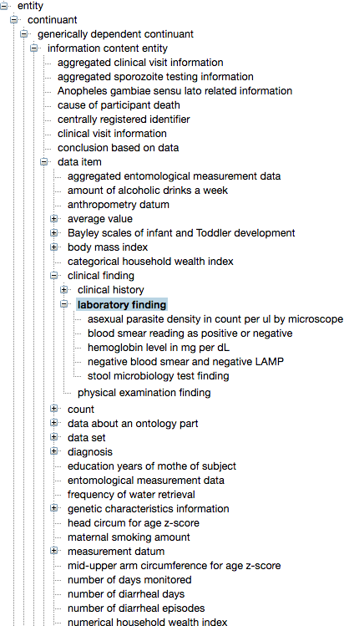
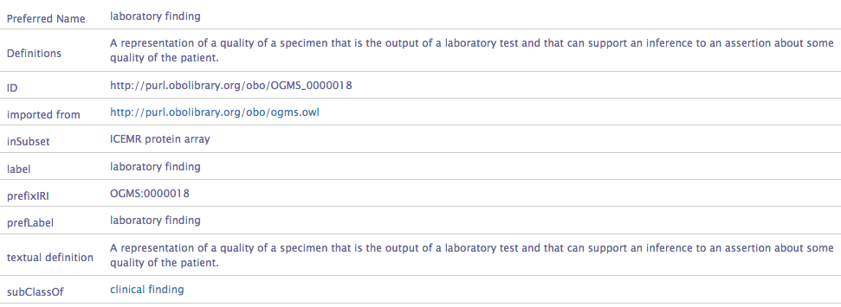
The EuPath Ontology
Metadata is not enough

Slide 22
Metadata is not enough
Coming soon with initial datasets on malaria surveillance and enteric pathogens
Focus is on people and how their environment impacts disease
Data collected on more than a hundred variables for each!
Brianna Lindsay (project manager)
& the EuPathDB team

Slide 23
The EuPathDB Ontology helps us: 1. Encode understanding of variables 2. Enable us to track when variables from different projects are about the same entity 3. Provide semantic harmonization across projects for web sites
Metadata is not enough
Extract column headers from data files (variables)
Compare to EuPath ontology
Look for in OBO ontologies
Use previous associated web display
Jie Zheng
Cristian Cocos
Submit to OBO ontology
Add to EuPath ontology

Slide 24
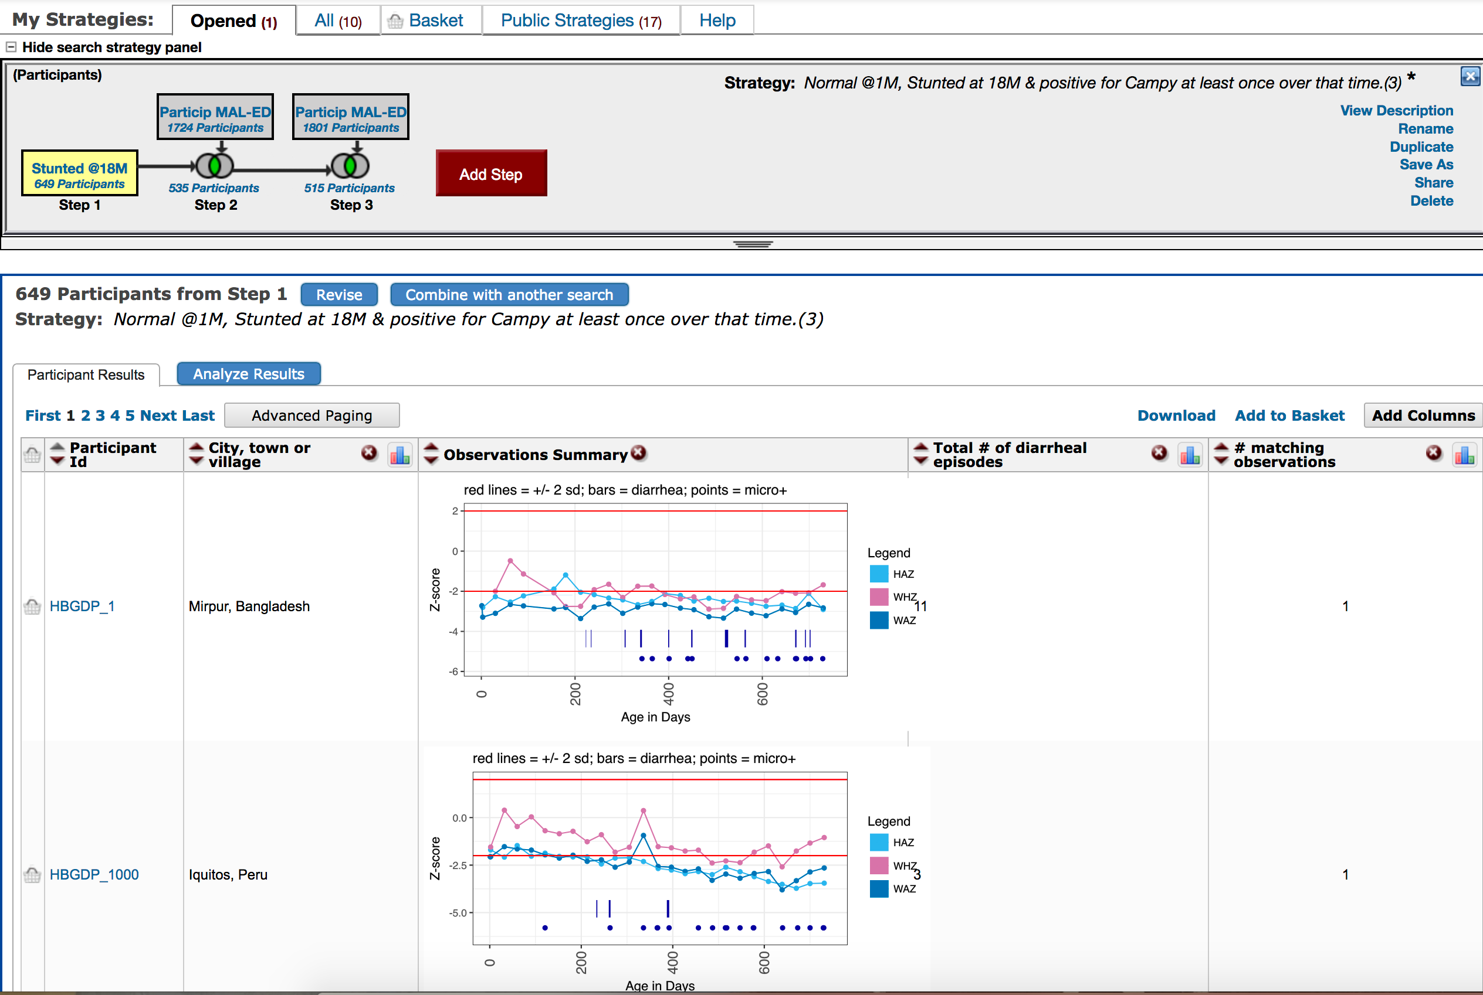
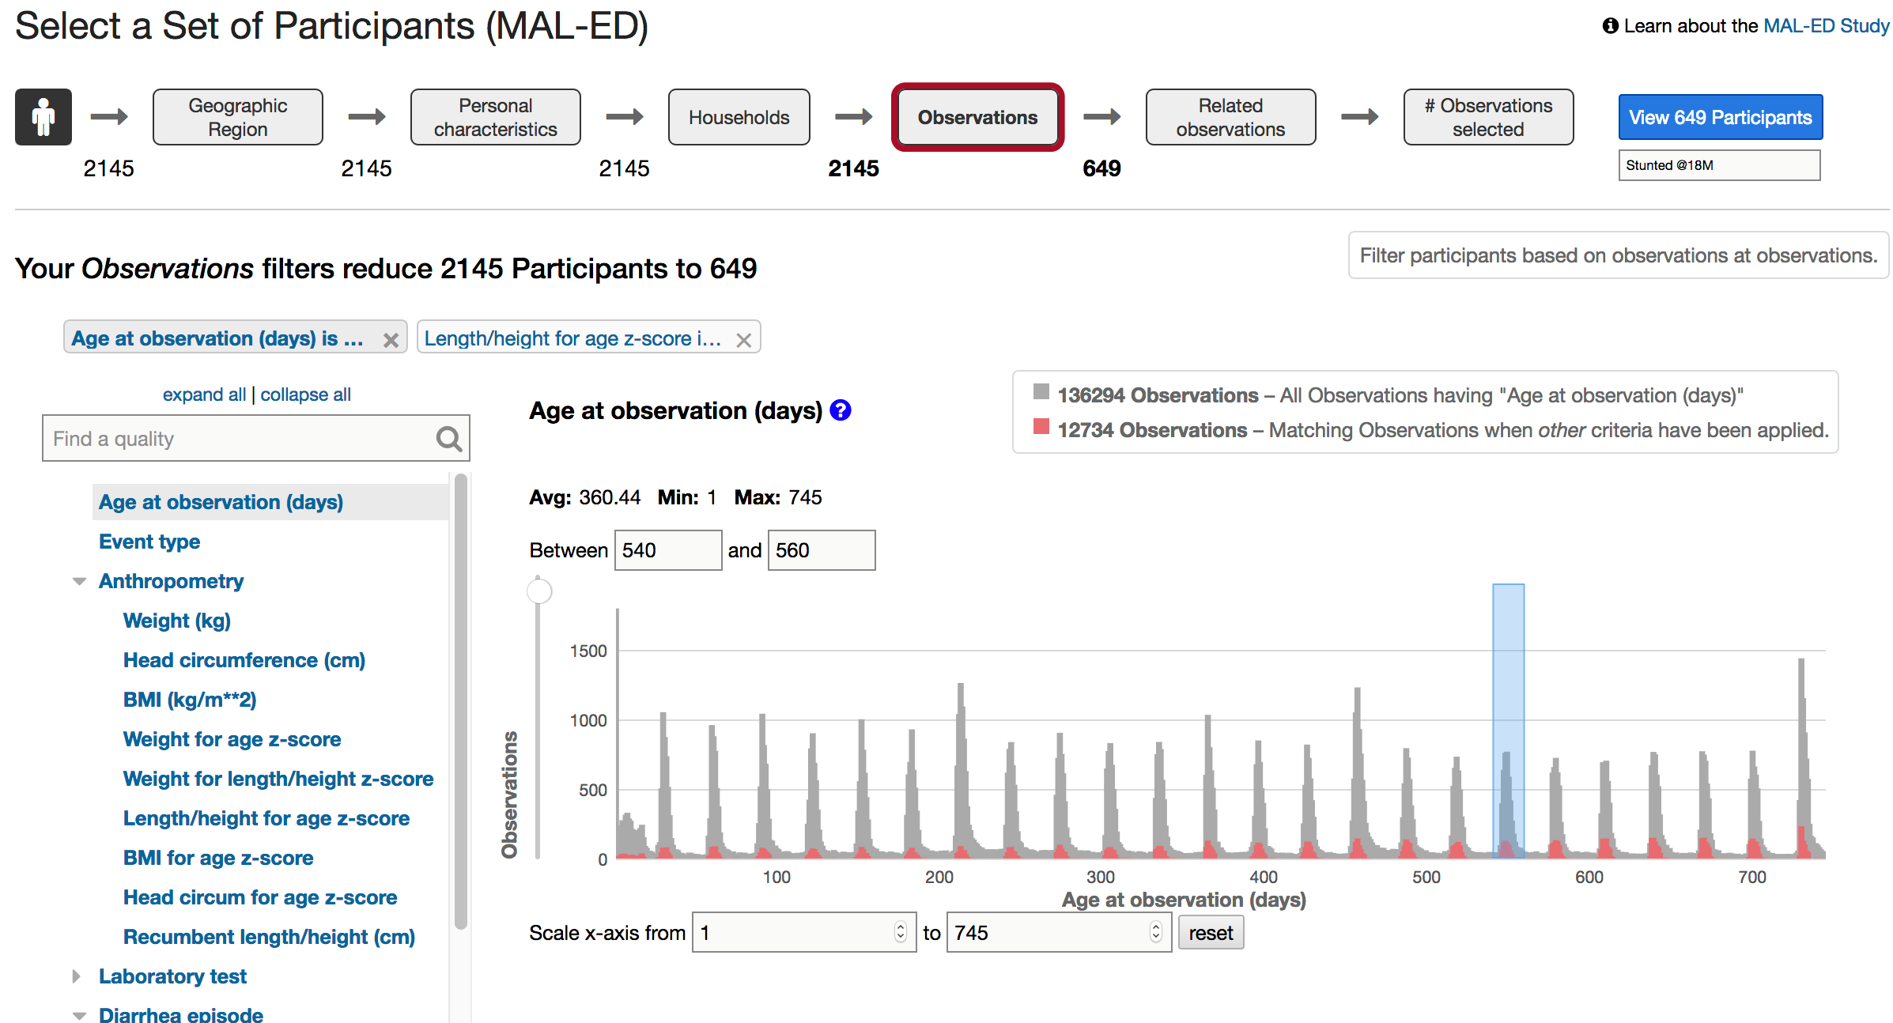
Metadata is not enough
Mapping to ontologies enables rich and consistent representation
Web terminology is scientist friendly
Brianna Lindsay (project manager)
& the EuPathDB team

Slide 25
Reification
and referents
Ultimately we would like to use the EuPath Ontology for instantiation of data on microbiome specimens and epidemiology data in triples that can be used to explore related observations and results across different projects and datasets.

Slide 26
Reification and referents
Reification and referents
reification is making something real, bringing something into being, or making something concrete.
https://en.wikipedia.org/wiki/Reification
Reification (Gestalt psychology), the perception of an object as having more spatial information than is present
Reification (Marxism) (German: Verdinglichung), the consideration, in Marxism, of an abstraction or an object as if it had living existence and abilities (also sometimes called "objectification", but see below)
Reification (computer science), the creation of a data model
Reification (fallacy), the fallacy of treating an abstraction as if it were a real thing
Reification (knowledge representation), the representation of facts and/or assertions
Reification (linguistics), the transformation, in natural-language processing, of a natural-language statement such that actions and events represented by it become quantifiable variables
Reification (statistics), the use of an idealized model to make inferences linking results from a model with experimental observations
referent: the object or event to which a term or symbol refers.
http://www.dictionary.com/browse/referent
referent tracking paradigm introduced in 2005 by Werner Ceusters, in which each real world entity is assigned its own unique ID. http://org.buffalo.edu/RTSdocument.html

Slide 27
Penn Medicine BioBank (PMBB) Queries – Current Day
Reification and referents
PMBB Participants View
PMBB LIMS
Penn
Data
Store
Penn Seek
Geno-mics?
Diagnoses
PMBB Data Broker
Investigator
Labs
Medications
Procedures

Slide 28
TURBO: Transforming and Unifying Research with Biomedical Ontologies
Reification and referents
Using ontologies for cleaning up, integrating, and interpreting clinical data for research
Initial focus is on biobank specimens and their donors
these can include microbiome specimens
Key processes are transforming relational data to triples, referent tracking, and generating assertions based on data.
Does NOT use EuPath ontology; uses a different application ontology (TURBO ontology) that is also BFO/OBI/OBO based.
Work in progress!

Slide 29
TURBO System
Reification and referents
TURBO
PMBB LIMS
Penn
Data
Store
Penn Seek
PMBB Data Broker
Penn Omics
Diagnoses
Investigator
Labs
Medications
Procedures

Slide 30
Current TURBO System
Reification and referents
RDMS
source
R2RML
TURBO GraphDB
PMBB Data Broker
Investigator
Karma
D2RQ
Referent Tracker
Conclusionator
TURBO ontology
Uses

Slide 31
Overview of the process of generating the graph for Phenotype Storefront queries
Reification and referents
“treating data as about
something real”
The modeling and reification process is used to produce evidence graphs from relational data sources. The evidence graphs express ground truths (person P exists), information entities (the row associated with biological sex for person P on form C has an entry ‘F’), and assertions (a value of ‘F’ denotes P is female). Referent tracking is used during the instantiation process for the uniform assignment of identifiers in the evidence graph (person P always has identifier ID-1234). The rules engine is used to draw and instantiate conclusions from assertions (there are multiple non-conflicting assertions P is female, so instantiate the conclusion that P is female, and confidence in that conclusion is high).

Slide 32
TURBO development: User Stories
Reification and referents
Development is being driven by a series of “User Stories” (Use Cases)
Common requests from researchers for patient cohorts and associated specimens.
Establish short term deliverables that provide demonstrations of what the TURBO system can deliver.
Focus story on addressing one type of problem associated with the requested data.

Slide 33
What can TURBO deliver: First user story
Reification and referents
Heather Williams, David Birtwell, Hayden Freedman, Mark Miller
There are files that contain data about patients, healthcare encounters, and patient-encounter links. These data are loaded into the TURBO graph and then conclusions are made about what are they in reality. The following questions will be asked:
What are the conflicting data in these two data sources?
How many patients of biological sex Male who are between the ages of 18 and 40 have been assigned a diagnosis for heart attack?
How many patients of biological sex Female who are between the ages of 22 and 50 have been assigned a diagnosis for heart attack?
The data sources have the columns addressing the following but inconsistently across files:
patient identifier
date of birth
gender identity datum
ICD code
date ICD code was assigned

Slide 34
TURBO Drivetrain processes
Reification and referents
From tabular files, Drivetrain uses the Karma application (http://usc-isi-i2.github.io/karma/) and TURBO ontology (Based on OBIB – https://github.com/biobanking/biobanking) to generate referents to people, their sex, and their birth dates.
Drivetrain is using Scala as application layer and Ontotext GraphDB.
Drivetrain similarly generates referents to patient health care encounters from a table of health care encounters and encounter (diagnosis) codes.
Referent tracking is used to collapse referents to unique identifiers.
Drivetrain generates assertions (conclusions) based on multiple data sources (which can include conflicts)
Assertions (RDF statements) on biological sex and on birth dates
Conclusionating processes have plan specifications (rules) that can be changed and tracked (Provenance!)
Assertions from conclusionating process using the same plan go into same named graph. Includes triples linking input data to assertions (‘supported by data’ relation).

Slide 35
Reification: Transforming relational data to ontology-based triples with Karma
health care encounter
Term IRI: http://purl.obolibrary.org/obo/OGMS_0000097

Slide 36
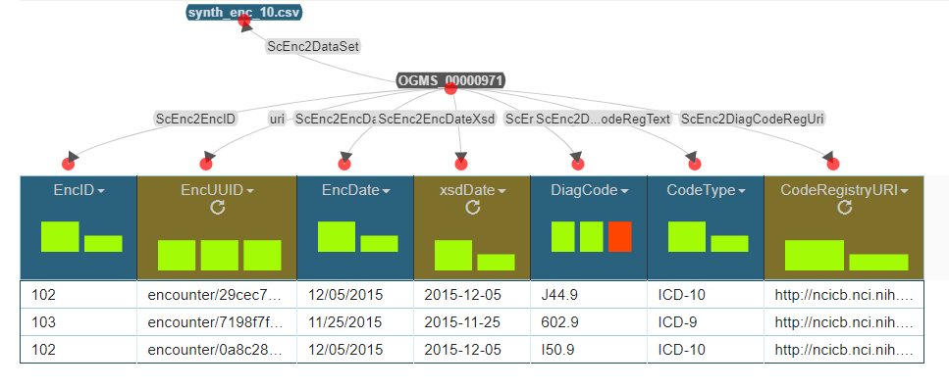
Shortcut: Transforming relational data to ontology-based triples with Karma
health care encounter
Term IRI: http://purl.obolibrary.org/obo/OGMS_0000097

Slide 37
TURBO Next steps
Reification and referents
Setting up server with real patient data
Documenting the system
Most of the effort has been on working through data quality (missing and conflicting values) and validation (correct form) issues.
Extending first user story
include body mass index
include medications
Establish second user story
biobank encounters (e.g., availability of specimens, type of consent)
enable searches that require knowing temporal relations of different encounters

Slide 38
Summary
Making progress in using OBO-based application ontologies to integrate datasets with rich multi-scale data.
Using these application ontologies to provide consistent modeling of data (e.g. EuPath)
Working toward using application ontologies to provide programmatic evaluation and rule-based interpretation of data with associated provenance.

Slide 39
In conclusion
Study design and details are not metadata but key data in themselves.
Using an application ontology provides model consistency; using an associated web terminology provides scientist-friendly representation.
Reification and referents can be the future of understanding complexity in clinical, epidemiological, and microbiome data through ontologies.

Slide 40
Thank you
EuPath team
David Roos (PI)
Jessie Kissinger (Co-PI UGA)
Chris Stoeckert (Co-I)
Christiane Hertz-Fowler (WT PI Liverpool)
Cristina Aurrecoechea
Ana Barreto
Eve Basenko
Bob Belnap
Austin Billings
John Brestelli
Brian Brunk
Shon Cade
Danielle Callen
Cristian Cocos
Katherine Crouch
Ryan Doherty
Dave Falke
Steve Fischer
Bindu Gajria
Omar Harb
Mark Heiges
Sufen Hu
Jay Humphrey
John Iodice
Cris Lawrence
Wei Li
Brianna Lindsay
Debbie Pinney
Jane Pullman
Achuchuthan Shanmugasundram
Drew Spruill
David Starns
Haiming Wang
Susanne Warrenfeltz
Jie Zheng
MicrobiomeDB
Dan Beiting (PI)
Gabriel Fernandes (Co-I Belo)
Francislon Oliveira
EuPath Team
TURBO team and governance
David Birtwell
Heather Williams
Mark Miller
Hayden Freeman
Jason Moore
Scott Damrauer
Mike Feldman
Pete Gabriel
John Holmes
Dan Rader
Referent tracking
Werner Ceusters
William Hogan

