Slide 1
Microbiology Data in the Real World Thoughts and Examples from One Site
Gigi Lipori, MT, MBA
UF Health and UF Health Sciences Center
Gainesville, FL

Slide 2
Introductory thoughts
Notes:
2
Need

Slide 3
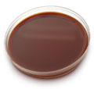
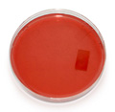
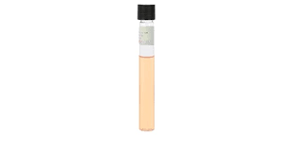
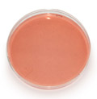
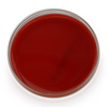
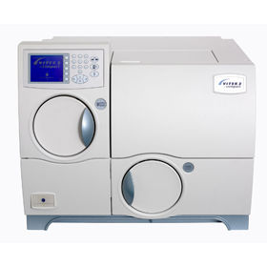
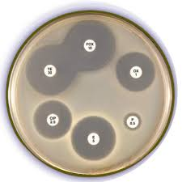
The “multiples”
One specimen….
Multiple derivatives
Multiple time points
Multiple versions
Multiple organisms
Multiple assays
Multiple antibiotics
Multiple datatypes
Qualitative, Semi-quantitative, Quantitative
Multiple “nomenclatures”
Multiple ontologies
SNOMED CT, LOINC, RxNORM
GNB
GPB
M/I/U
Oxidase
X/V/SAT
CHO
Coagulase
Catalase
Optochin
Rhoads, D. D., Sintchenko, V., Rauch, C. A., & Pantanowitz, L. (2014). Clinical microbiology informatics. Clin Microbiol Rev, 27(4), 1025-1047. doi:10.1128/CMR.00049-14
Notes:
,

Slide 4
The “annotations”
Was it a pathogen?
Was it hospital acquired?
Was there an associated device/procedure?
What was the original source of infection?
Was the infection externally reportable?
What were the patient’s characteristics?

Slide 5
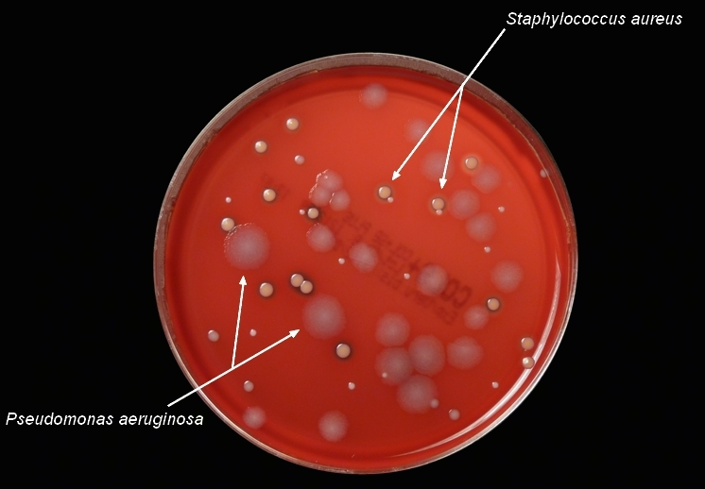
An example case

Slide 6
Day 0
BAP
ANA BAP
MAC
Choc
Thio
Day 1
Isolate 1:
3+ GNR Presumptive Pseudomonas
Gram stain
Oxidase
Sub to Mac
GNR ID Vitek
GNR AST Vitek
Isolate 2:
3+ GPC Presumptive Coag Pos Staph Sp
Gram stain
Staph Latex
GP ID Vitek
GP AST Vitek
Sub to BAP
Day 2
Isolate 1:
3+ Pseudomonas aeruginosa
Amikacin <= 2 S (P)
…
Tobramycin <= 1 S (P)
Isolate 2:
3+ Staphylococcus aureus
Penicillin 0.25 R (P)
…
Vancomycin <= 0.5 S (P)
Day 3
Isolate 1:
3+ Pseudomonas aeruginosa
Amikacin <=2 S
…
Tobramycin <=1 S
Isolate 2:
3+ Staphylococcus aureus
Penicillin 0.25 R
…
Vancomycin <=0.5 S
1
2
3
1p
1f
4
5
6
3p
12p
3f
12f
7
8
11p
20p
11f
20f
Empiric IV vancomycin
9
PO cephALEXin
10
2p
2f
11
21p
37p
21f
37f
12
13
36p
52p
36f
52f
14
15

Slide 7
One swab
Clinical Microbiology
Infectious Diseases
15 derivative samples
52 bug/drug results
Temporal considerations
Version considerations
Linking considerations
4+ informational results
Collection information
Source
Collection date/time
Collecting person
Transport information
Received date/time
Timely escalation/de-escalation of therapy?
Colonization or infection?
Hospital acquired?
Associated device/procedure?
Original source of infection?
Externally reportable?

Slide 8
Multiple transmissions
Example HL7 segments
Non-electronic CCD
SPM|1|||74964007^OTHER^SCT^^^^^^Other||||LEGR^Leg, Right ^^^^^^^Leg, Right |||||||||<specimen received date/time>|<specimen collection date/time>||||||
OBX|2|CWE|632-0^Bacteria Wnd Aerobe Cult^LN^^^^LOINC(R) Database Version ^^WOUND CULTURE RESULT|2|123004^STAPHYLOCOCCUS AUREUS^^^^^^^STAPHYLOCOCCUS AUREUS||||||P|||< observation date/time >|||||< analysis date/time>||||<performing organization name>|performing organization address>|
NTE|1|L|3+ Staphylococcus aureus|
OBX|1|ST|12-5^Amikacin Islt MIC^LN^^^^LOINC(R) Database Version ^^Amikacin |1||||Susc|||P|||<observation date/time>|||||<analysis date/time>||||<performing organization name>|<performing organization address>|

Slide 9
Multiple ontologies
SOLOR (SnOmed LOinc Rxnorm)
SNOMED CT
Pseudomonas aeruginosa (organism) [52499004]
Staphylococcus aureus (organism) [3092008]
LOINC
Bacteria Identified In Wound By Aerobe Culture [632-0]
RxNorm
Amikacin [641 IN]
2 ML Amikacin 250 MG/ML Injection [1723156 SCD]
4 ML Amikacin 250 MG/ML Injection [1723160 SCD]
Amikacin Sulfate 5 MG/ML Injectable Solution [905156 SCD]
Amikacin Sulfate 50 MG/ML Injectable Solution [905148 SCD]
Amikacin Sulfate 62.5 MG/ML Injectable Solution [905154 SCD]
Others?
https://loinc.org/collaboration/snomed-international/
http://doc.ihtsdo.org/download/xdoc_SnomedCtAndLoincGuide_Current-en-US_INT_20141014.pdf

Slide 10
Multiple “nomenclatures” Example: Escherichia coli in Urine
Pre-Beaker
Post-Beaker
5 order ids
11 test ids
27% of results loinc’d (3 loincs)
227 ways “Escherichia coli” reported
4 order ids
9 test ids
99% of results loinc’d (1 loinc)
77 ways ”Escherichia coli” reported
Notes:
Pre-beaker
UF
82 ways resulted – 79 contain Escherichia coli
2 ways to order
4 ways to result
JAX
111 ways resulted – 109 contain Escherichia coli
1 way to order
4 ways to result
Post-beaker
UF
6 ways resulted – all contain Escherichia coli
1 way to order
1 way to result
JAX
54 ways resulted – all contain Escherichia coli
1 way to order
1 way to result

Slide 11
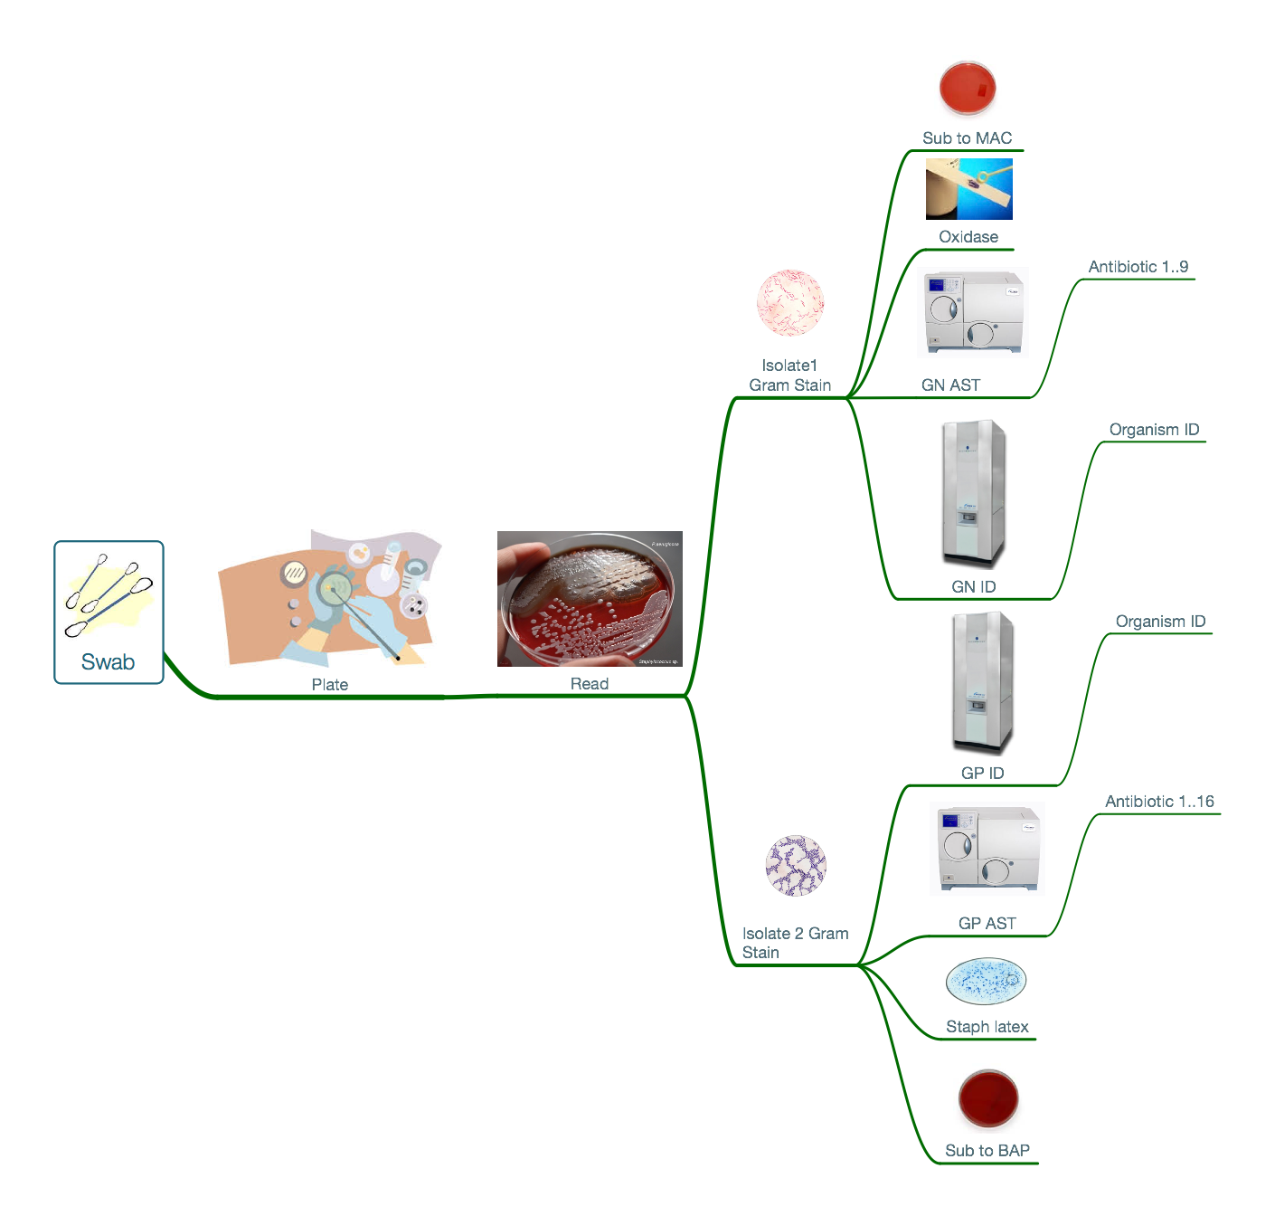
Summary
The ”multiples”
1 Specimen
15 physical entities
52 reportable results
Nomenclature
3+ Ontologies
Numerous ways the same entity is represented in the raw data
The “annotations”
The specimen
The patient
Demographics
Anthropomorphics
Procedures
Diseases
Drugs
Devices
The bug
Pathogen
Colonizer
Normal flora
Contaminant
The ward
The care team
The community

Slide 12
?

Slide 13
Background on role

Slide 14
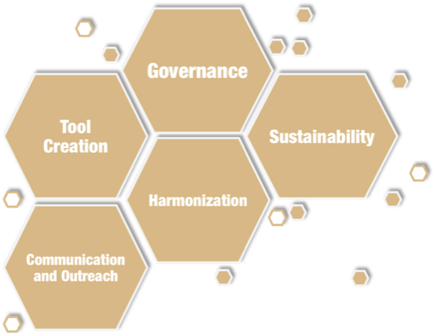
Vision
collect
store
harmonize
anaylze
use
Support UF Health and UF Health Sciences Center comprehensive mission – patient care, research and education – through ready access to synthesized information, powerful analytical tools and robust information infrastructure.
Notes:
Questions? Help? i2b2support@ahc.ufl.edu

Slide 15
Curation process
Need
Collaborate
Define
Extract
Represent
Audit

